Slide 1



PAS10 CA Property Conversions Regression Test Approach
October 10, 2016
Quality Assurance

Slide 2
Agenda
Regression testing summary - CA Property Conversions (Homeowners, DP3,PUP)
Regression scope summary - CA Property Conversions
Integrations regression testing summary - CA Property Conversions
Packet Print regression testing summary - CA Property Conversions

Slide 3
Regression Testing Summary - CA Homeowners Conversions
As per PAS10 scope, below are the major additions and enhancements to CA Property conversions from HDES which mainly contains HO3,HO4 and HO6 products
New Conversion specific functionalities (applicable to converted policies)
Forms specific to converted policies implemented (Renewal Reminder - Home Banking, Pre renewal form etc.)
Enhancements to generic functionalities (applicable to both organic and converted policies)
Existing CA eligibility rules modified
Existing CA property forms retired and replaced with new forms
Coverage limits are altered

Slide 4
Regression Scope Summary - CA Homeowners Conversions (1/2)

Slide 5
Regression Scope Summary - CA Homeowners Conversions (2/2)

Slide 6
Homeowners Conversion Illustrative Test Scenario
CA Homeowners scenario will cover various functionalities from conversion timeline (R-58 to R) till 2nd Renewal of policy in PAS (2R).
Following diagram depicts a scenario which covers conversion specific functionalities during conversion timeline, followed by generic functionalities once policy is converted into PAS.
Conversion Specific Functionality
Generic Functionality
Conversion Renewal
(R-58)
Conversion Renewal
(R-48)
Conversion Renewal
(R-10)
Conversion Renewal (R+1)
Midterm Changes/Cancellation/Reinstatement/Rewrite
Renewal
(2R)
Billing
Privilege and Task Management
Policy is imported from HDES legacy to PAS
Converted policy Active in PAS
Cancellation Notice
Non Pay Cancel
Lapse Notice
Reinstatement W/O Lapse
Renewal offer cover letter for converted policy –Insured / Mortgagee Bill
Renewal Reminder (Home Banking) form 61 0069 for converted policy
Renewal Offer Cover Letter Mortgagee Bill
Renewal Status
Membership validation at renewal
Change payment on current term of policy
Renewal Bill
Automatic renewal with lapse

Slide 7
Regression Testing Summary - CA DP3/PUP Conversions
Following major functionalities are implemented as part of CA Property conversions from SIS and Foxpro, which mainly contain DP3 and PUP products respectively.
New functionalities (Applicable to converted policies)
Premium Variance rules
Prior term balance transfer
Operational reports
Generation of forms for converted policies
Suppression of forms for converted policies

Slide 8
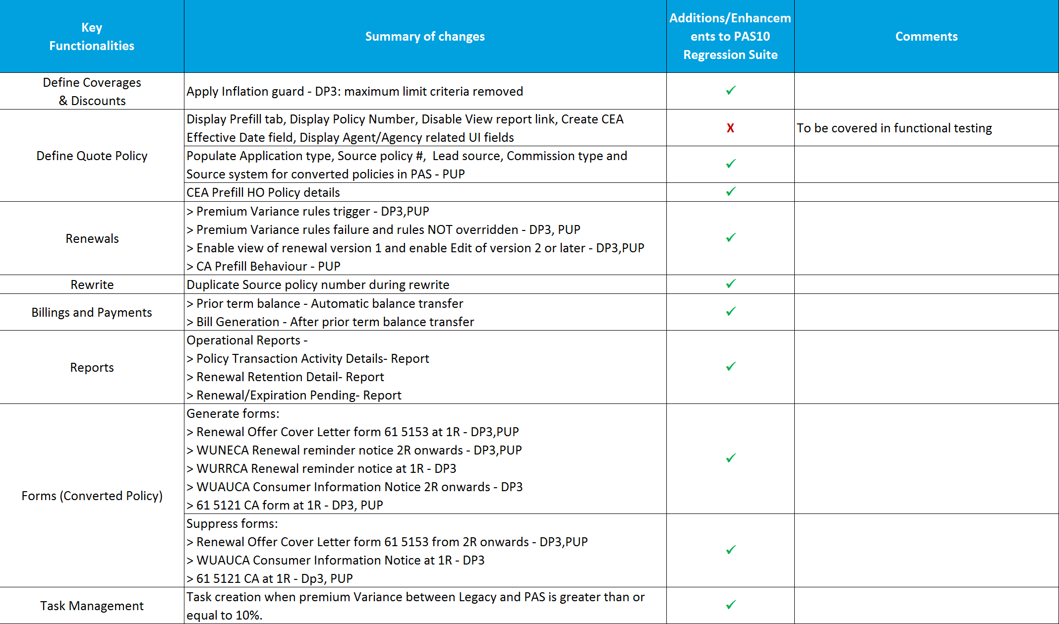
Regression Scope Summary - CA DP3/PUP Conversions

Slide 9
Integrations Regression Testing Summary - CA Conversions
Based on the priority of an interface, impact of conversion on it and current regression timelines, 13 interfaces have been categorized as ‘In Scope’ for PAS 10 regression testing for converted policies.
5 of 13 (in green) will be validated by system owners and 8 (in grey) require file or system validations.

Slide 10
Packet Print Regression Testing Summary - CA Conversions
For Packet Print Conversion testing, renewal packets would be generated for all three legacy system sources and submitted for review.
Each packet would comprise of 4 policies.
For CA Homeowners, once the policy is imported and a part of PAS, we would be generating packets for billing and cancellation on the policy as well, each packet comprising of 4 policies.
New Business packets are not in scope for conversion.
Product | New Business | Billing | Cancellation | Renewal | Total
CA Homeowners | 0 | 4 | 4 | 4 | 12
CA DP3 | 0 | 0 | 0 | 4 | 4
CA PUP | 0 | 0 | 0 | 4 | 4
Total | 0 | 4 | 4 | 12 | 20

Slide 11
Appendix
List of CA Regression Scenarios
Sample Design – Standard Regression

